Slide 1

Gaussian Mixture Models
Amel Abdelraheem
Elysee Gasana
Ifeoma Veronica Nwabufo
Joseph Nwanna
22 April 2022 Project 6-Group 8

Slide 2
Table of contents
01.
Introduction
02.
Preprocessing Techniques
03.
Text Embeddings
04.
Gaussian Mixture Models
Gaussian Mixture Models
AMMI 2022/23

Slide 3
Task Formulation & Setup
Pre-Processing
AMMI 2022/23
Sentiment Analysis: Detects the underlying sentiment in a piece of text (Positive, Negative)
This can be useful when collecting reviews of a specific product or service
In this project we looked at movie reviews collected from the IMBD website

Slide 4
Clean Text
Pre-Processing
AMMI 2022/23
We begin by removing punctuations from our text.
We also change all the letters to lowercase, otherwise later on pairs like ‘Clean’ & ‘clean’ will be given separate representations
Lastly we split the text into an array of words for further processing.

Slide 5
Stop Words
Pre-Processing
AMMI 2022/23
Stop words are Common words that appear frequently in text
removing these will increase computation and space efficiency.
These words may not be indicative of the contextual content behind the text
e.g.
‘this’, ’you’, ‘are’, ‘have’,‘has’, ‘had’...etc
We define a list containing all the stop words and then search and remove them from our text

Slide 6
Stemming/Normalizing Text
Pre-Processing
AMMI 2022/23
Porter Stemmer:
Any word can be broken down to units of consonant & vowel letters [C]VC…[V]. (the brackets denote that the first & last units are optional).
Porter then defines a number m such that [C]VC{m}[V], this will be a guide to how and when we should stop trimming the suffixes.
This algorithm is not concerned with the readability of the resulting base.
The rulings used only work on the english language as it’s derived from common patterns.

Slide 7
Pre-Processing
AMMI 2022/23
Porter Stemmer Algorithm:
Check if the word is in plurals or past participles format:
i.e :
SSES -> SS
IES -> I
ING -> None
Check if m>0 and replace some common terminations:
i.e:
ATIONAL -> ATE
TIONAL -> TION
Check if m>0 and replace these terminations:
i.e:
ATIVE -> None
Check if m > 1 and remove suffixes:
i.e :
AL -> None
ANCE -> None
Final check if m>1 and if the last letter is E*:
i.e:
E -> None

Slide 8
Text Embeddings
Frequency count, TF-IDF

Slide 9
Frequency Count
Text Embedding
AMMI 2022/23
Simply count the occurrences of a word within all the documents and use that as your representation
 | Word_1 | Word_2 | Word_3
Doc 1 | 1 | 0 | 2
Doc2 | 1 | 4 | 0
Embed. | 2 | 4 | 2

Slide 10
Term Frequency - Inverse Document Frequency
Text Embedding
AMMI 2022/23
It is a statistical measure that evaluates how relevant a word is to a document in a collection of documents ⇒ less common words have higher weights suggesting that they are more indicative of the context
Term Frequency: how many times a word appears in a document divided by the total number of words in the document
Inverse Document Frequency: the log of dividing the total number of documents by the number of documents in which the word appears in
Tf = word_freq ∕ tot_words_doc
Tdf = log [tot_docs ∕ docs_with_word]
Tf-Idf = Tf * Idf

Slide 11
Gaussian Mixture Model
Popular alternative to K-Means clustering .
A probabilistic model for clustered data with real-valued components.
Model the data as a weighted sum of gaussian distributions.
It is a soft clustering algorithm; meaning all the points have probabilities describing their belonging to the data.

Slide 12
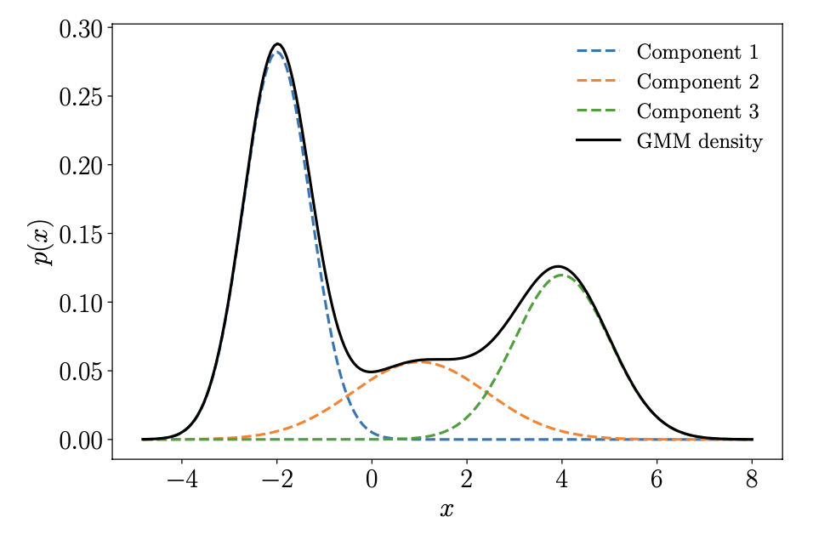
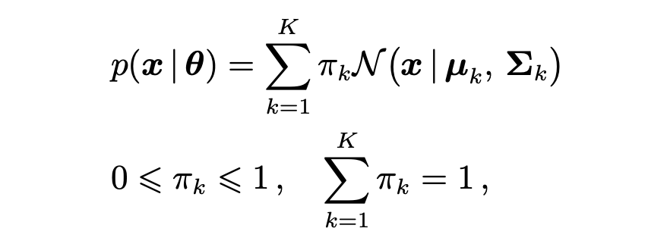

Gaussian Mixture Models
AMMI 2022/23
* Deisenroth, M.P., Faisal, A.A. and Ong, C.S., 2020. Mathematics for machine learning. Cambridge University Press.

Slide 13
Good old Maximum Likelihood Estimation (MLE)?
Gaussian Mixture Models
AMMI 2022/23

Slide 14
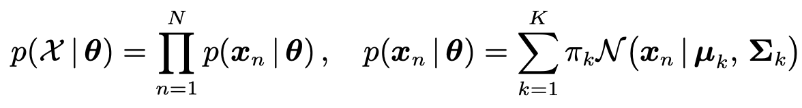
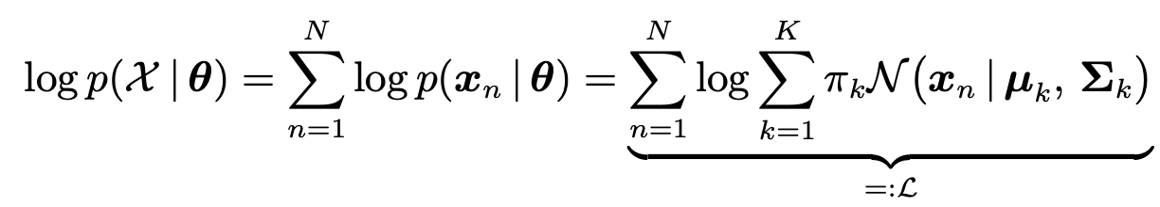
Gaussian Mixture Models
AMMI 2022/23

Slide 15
No Closed Form
Solution!
Gaussian Mixture Models
AMMI 2022/23

Slide 16
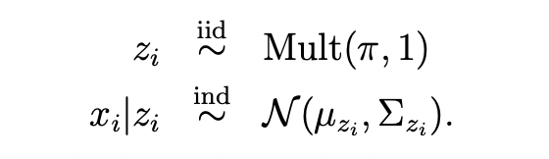
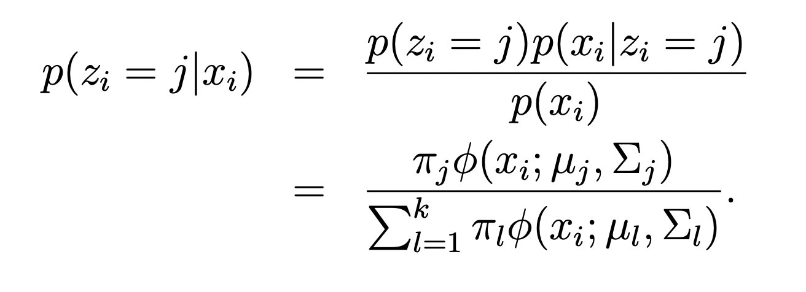

Latent Variable Perspective
Gaussian Mixture Models
AMMI 2022/23
A GMM has an equivalent representation as a generative model for our data:
where zi represents the latent component indicator or latent class / cluster for datapoint xi
If we assume we have an initial GMM, our clustering task amounts to inferring the latent component zi responsible for each xi
*STATS 306B: Unsupervised Learning, Lester Mackey

Slide 17
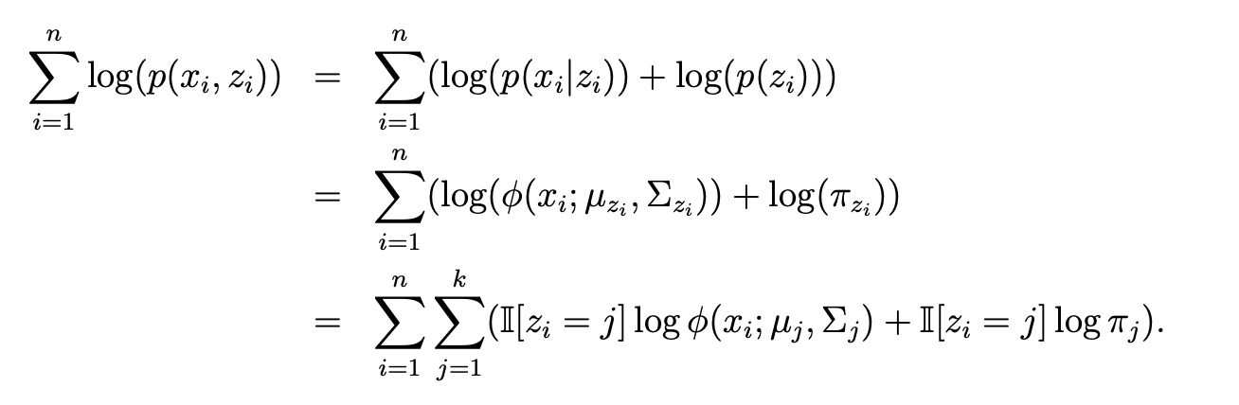
Latent Variable Perspective
Gaussian Mixture Models
AMMI 2022/23
Before we observe xi , we have the prior belief that it belongs to cluster j with probability πj ; after observing xi , we can update this belief in accordance with the likelihood of xi under each Gaussian component
If we knew the zi ’s, then the problem of the sum inside of each log (representing an expectation over an unknown cluster assignment zi) would be solved, since we could instead maximize the complete log likelihood
*STATS 306B: Unsupervised Learning, Lester Mackey

Slide 18
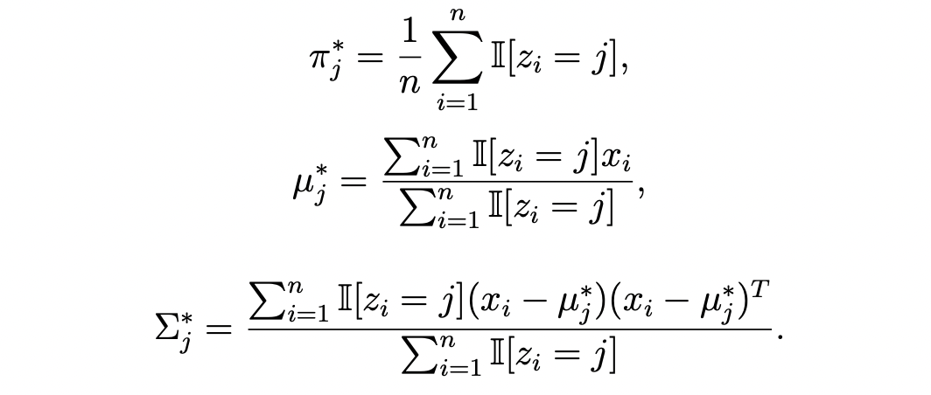
Latent Variable Perspective
Gaussian Mixture Models
AMMI 2022/23
The complete log likelihood, viewed as a function of the parameters of the GMM(π, µ, Σ), has closed form maxima:
If we knew the zi ’s, then the problem of the sum inside of each log (representing an expectation over an unknown cluster assignment zi) would be solved, since we could instead maximize the complete log likelihood
*STATS 306B: Unsupervised Learning, Lester Mackey

Slide 19
Expectation
Maximization
Gaussian Mixture Models
AMMI 2022/23
The Expectation-Maximization (EM) algorithm, leverages the latent-variable problem structure to form parameter estimates.
If we could change the summation term inside the log, we could easily carry out the MLE ⇒ Initialize values for the parameters
We will then estimate the distribution given the data and the current value of the parameters
Next, we can estimate cluster assignments using probabilistic inference
*STATS 306B: Unsupervised Learning, Lester Mackey

Slide 20

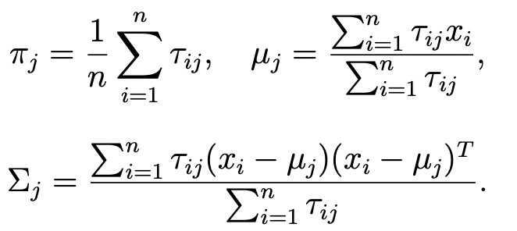
Gaussian Mixture Models
AMMI 2022/23
Expectation-Maximization for GMMs:
Initialize cluster weight(π), and for each gaussian assign mean and covariance values(µ, Σ)
Alternate until convergence:
(E-step) [Expectation step]: Compute soft class memberships (probabilities), given the current parameters:
(M-step) [Maximization step]: Update parameters by plugging in τij (our guess) for the unknown I[zi = j], which gives us:
This is similar to the case in which all zi ’s are known, but now each xi is partially assigned to each cluster j through the conditional probability that zi = j.
*STATS 306B: Unsupervised Learning, Lester Mackey

